Slide 1

Peeling Success:
A data driven look improving retention and employee outcomes.

Slide 2

Table of contents
01
02
03
EDA
The Results
The Benefits

Slide 3


Payden Bullis
pbullis@mail.smu.edu

Slide 4

01
EDA

Slide 5


Slide 6

Assumptions
Based on the data in question and the project outline there are some assumptions to cover:
Independence:
We are assuming the data provided demonstrates attrition results which are voluntary and involuntary terminations that are independent, of a larger event (specifically, they were not part of a corporate restructure, reduction in workforce, furlow, etc.) Further we assume that each individual metric is independent of one another for the purposes of determining the ultimate outcome.
Impact:
We assume that the attrition metric is not desirable, and the intent is to predict potential employees at risk of quitting or being fired in order to introduce additional resources for that employee to provide a new more positive outcome.

Slide 7

Dispelling Misconceptions
Conventional wisdom did not lead to obvious trends such as:
Pay and Compensation
Gender
Tenure or “job hopping”

Slide 8

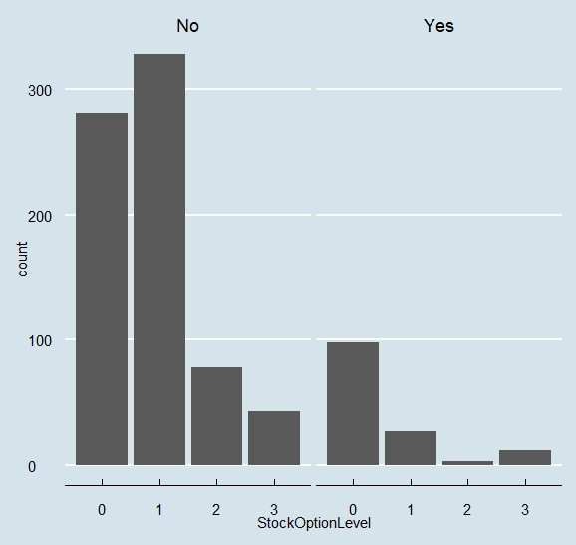
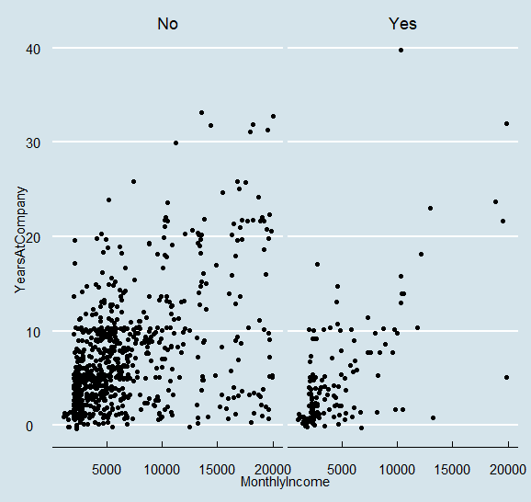
Pay and Compensation insights
Attrition by Gender and Age
Tenure and Monthly Income

Slide 9

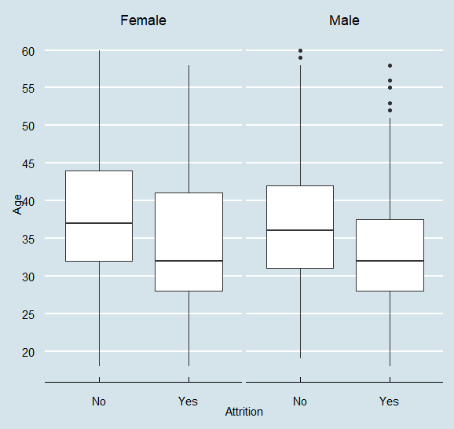
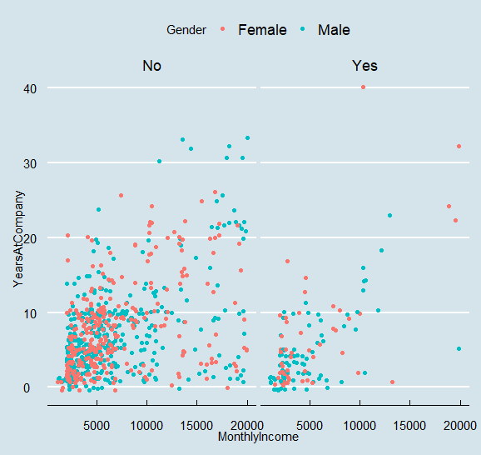

Gender Trends
Attrition by Gender and Age
Attrition by Tenure and Income

Slide 10
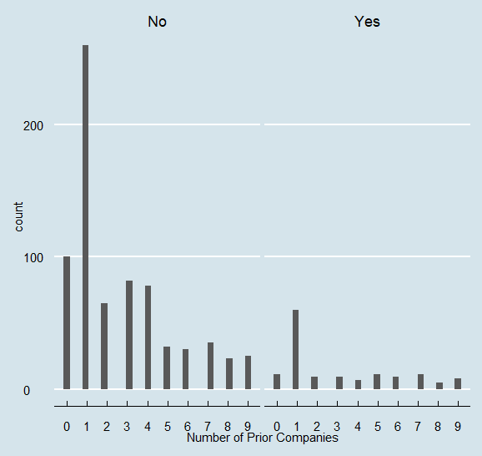
“Job Hopping”
Attrition by Number of Companies Prior

Slide 11
Useful Insights
The trends and patterns with the most obvious impact.
Department
Job level
Survey results

Slide 12

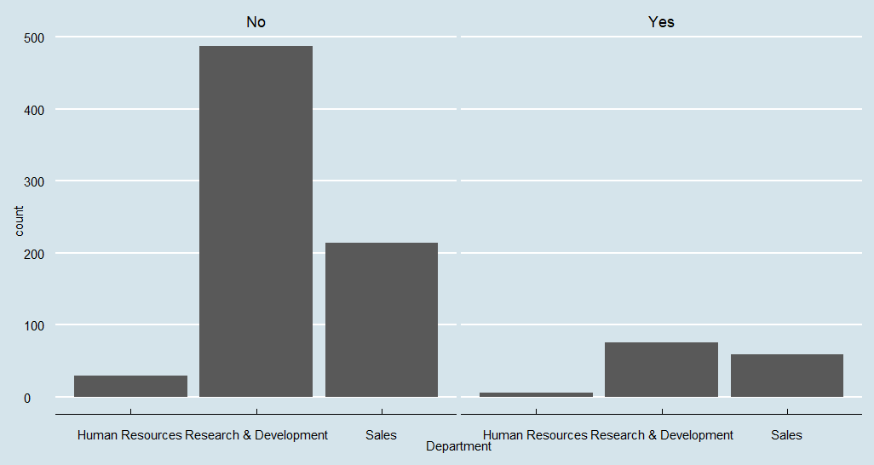
Department Differences
Attrition by Department

Slide 13
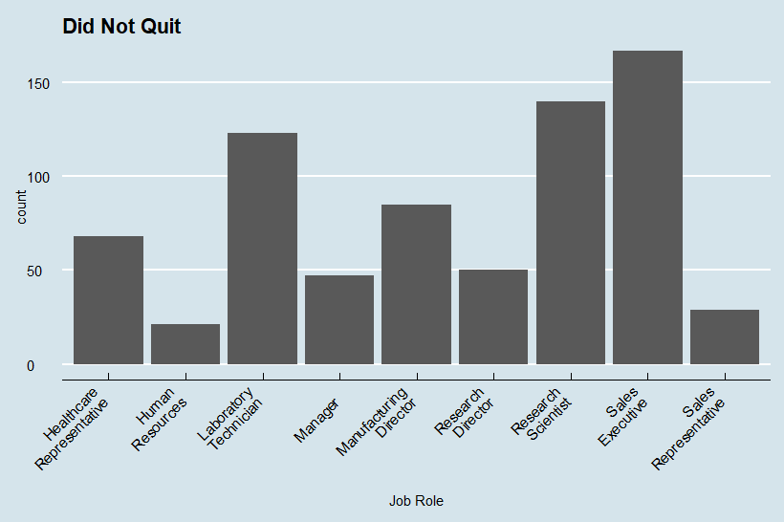
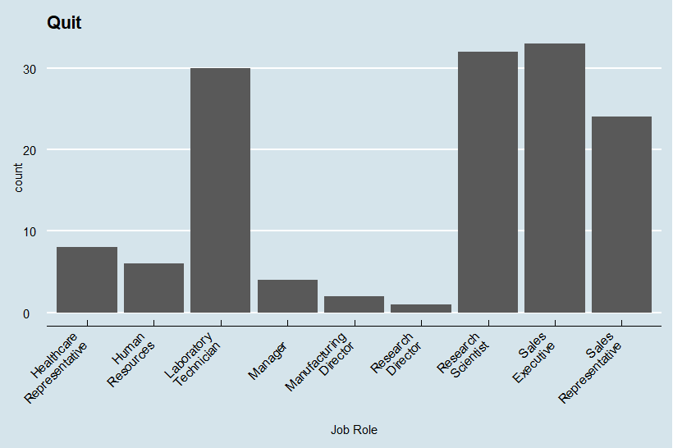
Department Differences
Retention by Job Role
Attrition by Job Role

Slide 14
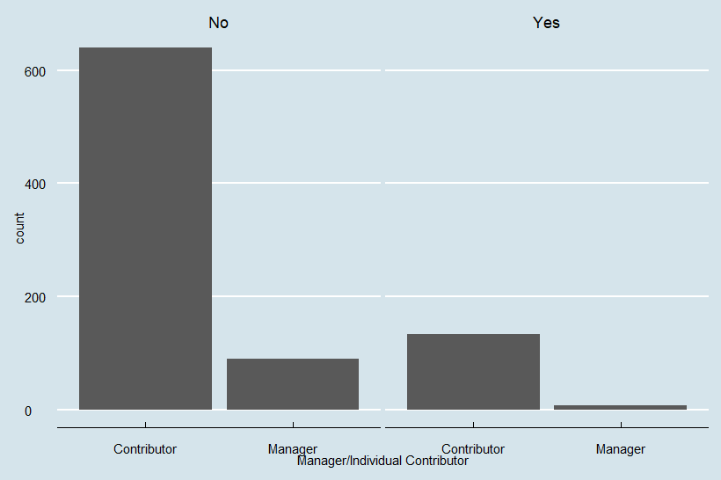
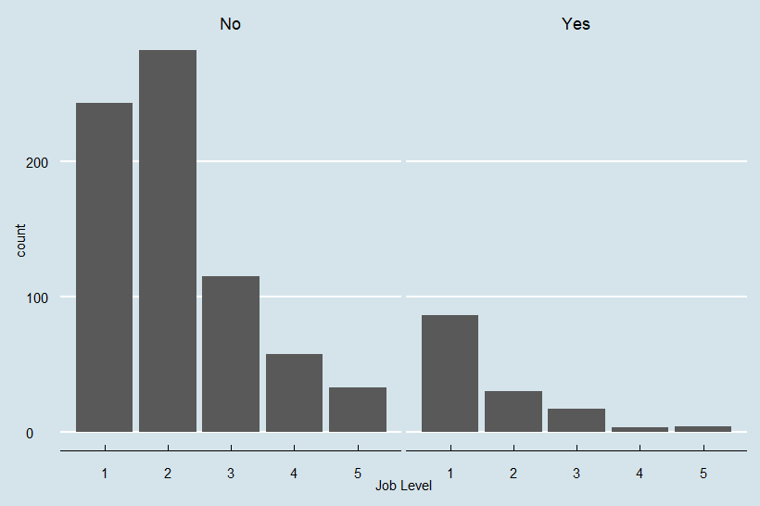
Job Level – Manager Split
Grouped by level 4 & 5 as Manager
Overall Job Level Attrition

Slide 15
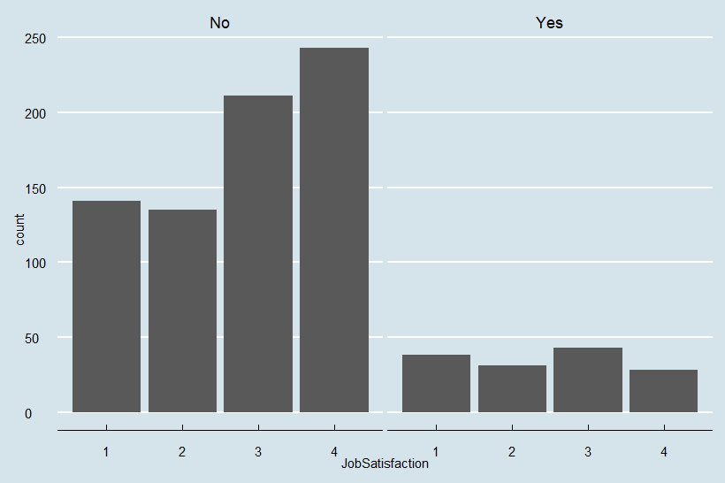
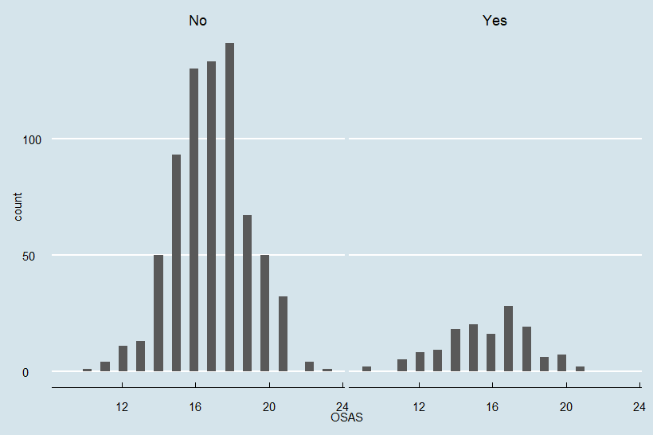
Survey Questions
Retention by Job Role
Retention by Job Role
*This is the sum of all the scores of the “survey questions” categories

Slide 16

Data insights
Position
Job Level
Department and Role played a large role in attrition.
Very few Directors and Managers left.
Gender
Surveys
Pay
Gender was largely not an effect
Low overall satisfaction scores were predictors.
Monthly Rate and Monthly Income were subtle.

Slide 17
02
Results

Slide 18
9h 55m 23s
333,000
The Model

Slide 19

Model Success Rates
81%
84.9%
60.5%
Accuracy
Sensitivity
Specificity
Accuracy is the percentage of “correct” results among the total number of items reviewed.
Sensitivity is the percentage of True Positives that were correctly predicted
Specificity is the percentage of True Negatives that were correctly predicted.

Slide 20

03
The Benefits

Slide 21

Insights and Limitation
Insights
Limitations
Sales Teams appear to be impacted the most.
HR seems to have a low turnover rate.
Overall compensation package (401k, insurance
Voluntary/involuntary attrition
Additional data on the survey scores could improve it’s predictive qualities

Slide 22
Thanks!
Do you have any questions?
pbullis@mail.smu.edu
8176475043
Place Holder Name

Slide 23


